Slide 1
Unit 2 The Stack
Compiled BY:
Ghanashyam BK

Slide 2

Stack Data Structure
a linear data structure that follows the principle of Last In First Out (LIFO).
This means the last element inserted inside the stack is removed first.
You can think of the stack data structure as the pile of plates on top of another.
Put a new plate on top
Remove the top plate
And, if you want the plate at the bottom, you must first remove all the plates on top. This is exactly how the stack data structure works.
Fig: Stack representation similar to a pile of plate

Slide 3
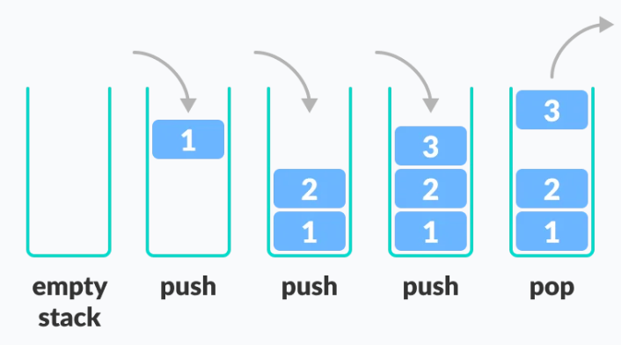
LIFO Principle of Stack
In programming terms, putting an item on top of the stack is called push and removing an item is called pop.
In the image, although item 3 was kept last, it was removed first. This is exactly how the LIFO (Last In First Out) Principle works.
Fig: Stack Push and Pop Operations

Slide 4
Stack as an ADT.
push() – Insert an element at one end of the stack called top.
pop() – Remove and return the element at the top of the stack, if it is not empty.
peek() – Return the element at the top of the stack without removing it, if the stack is not empty.
size() – Return the number of elements in the stack.
isEmpty() – Return true if the stack is empty, otherwise return false.
isFull() – Return true if the stack is full, otherwise return false.

Slide 5
Working of Stack Data Structure
A pointer called TOP is used to keep track of the top element in the stack.
When initializing the stack, we set its value to -1 so that we can check if the stack is empty by comparing TOP == -1
On pushing an element, we increase the value of TOP and place the new element in the position pointed to by TOP.
On popping an element, we return the element pointed to by TOP and reduce its value.
Before pushing, we check if the stack is already full.
Before popping, we check if the stack is already empty.

Slide 6
Implementation of Stack Operations
Creating Stack
#include<stdio.h>
#include<stdlib.h>
#define MAX 10
int count = 0;
//Creating Stack
struct stack {
int items[MAX];
int top;
};
typedef struct stack st;
Creating Empty Stack
void createEmptyStack(st *s){
s->top = -1;
}
Check if stack is empty
int isEmpty(st *s) {
if (s->top == -1)
return 1;
else
return 0;
}
Check if stack is full
int isFull(st *s) {
if (s->top == MAX-1)
return 1;
else
return 0;
}

Slide 7
Implementation of Stack Operations
Add Element into stack
void push(st *s, int newItem) {
if (isFull(s)) {
printf(“Stack Full”);
}
else {
s->top++;
s->items[s->top] = newItem;
}
count ++;
}
Remove Element from stack
void pop(st *s) {
if (isEmpty(s)) {
printf("\n STACK EMPTY \n");
} else {
printf("Item popped= %d", s->items[s->top]);
s->top--;
}
count--;
printf("\n");
}
Print elements in Stack
void printStack(st *s) {
printf("Stack: ");
for (int i = 0; i < count; i++) {
printf("%d ", s->items[i]);
}
printf("\n");
}

Slide 8
Implementation of Stack Operations
Main function
int main() {
int ch;
st *s = (st *)malloc(sizeof(st));
createEmptyStack(s);
push(s, 25);
push(s, 28);
push(s, 31);
push(s, 43);
printStack(s);
pop(s);
printf("\nAfter popping out\n");
printStack(s);
}

Slide 9
Applications of Stack
To reverse a word: Put all the letters in a stack and pop them out. Because of the LIFO order of stack, you will get the letters in reverse order.
In compilers: Compilers use the stack to calculate the value of expressions like 2+4/5*(7-9) by converting the expression to prefix to postfix form.
In browsers - The back button in a browser saves all the URLs you have visited previously in a stack. Each time you visit a new page, it is added on top of the stack. When you press the back button, the current URL is removed from the stack, and the previous URL is accessed.
The Stack is used to solve a few of the general problems like:
Tower of Hanoi
Infix to prefix conversion, etc.

Slide 10
Evaluation of Infix Expressions
Infix notation is commonly used in arithmetic formula or statements, the operators are written in-between their operands.
Let’s assume the below
Operands are real numbers.
Permitted operators: +,-, *, /, ^(exponentiation)
Blanks are permitted in expression.
Parenthesis are permitted
Example:
A * ( B + C ) / D
2 * (5 + 3) / 4
Output: 4

Slide 11
Evaluation of Infix Expressions
Approach: Use Stacks
We will use two stacks
Operand stack: This stack will be used to keep track of numbers.
Operator stack: This stack will be used to keep operations (+, -, *, /, ^)
Order of precedence of operations–
^ (Exponential)
/ *
+ –
Note: brackets ( ) are used to override these rules.

Slide 12
Evaluation of Infix Expressions
Process: (will be used for the main algorithm)
Pop-out two values from the operand stack, let’s say it is A and B.
Pop-out operation from operator stack. let’s say it is ‘+’.
Do A + B and push the result to the operand stack.

Slide 13
Evaluation of Infix Expressions
Algorithm:
Iterate through given expression, one character at a time
If the character is an operand, push it to the operand stack.
If the character is an operator,
If the operator stack is empty then push it to the operator stack.
Else If the operator stack is not empty,
If the character’s precedence is greater than or equal to the precedence of the stack top of the operator stack, then push the character to the operator stack.
If the character’s precedence is less than the precedence of the stack top of the operator stack then do Process (as explained in previous slide) until character’s precedence is less or stack is not empty.
If the character is “(“, then push it onto the operator stack.
If the character is “)”, then do Process (as explained in previous slide) until the corresponding “(” is encountered in operator stack. Now just pop out the “(“
Once the expression iteration is completed and the operator stack is not empty, do Process until the operator stack is empty. The values left in the operand stack is our final result.

Slide 14
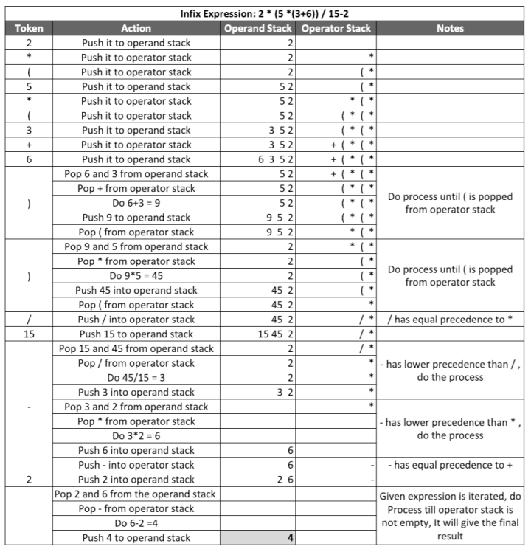

Slide 15
Evaluation of Postfix Expressions
Postfix notation is a notation for writing arithmetic expressions in which the operands appear before their operators.
There are no precedence rules to learn, and parentheses are never needed. Because of this simplicity.
Let’s assume the below
Operands are real numbers in single digits.
Permitted operators: +,-, *, /, ^(exponentiation)
Blanks are NOT permitted in expression.
Parenthesis are permitted

Slide 16
Evaluation of Postfix Expressions
Example
Postfix: 54+
Output: 9
Explanation: Infix expression of above postfix is: 5+ 4 which resolves to 9
Postfix: 2536+**5/2-
Output: 16
Explanation: Infix expression of above postfix is: 2 * (5 *(3+6))/5-2 which resolves to 16

Slide 17
Evaluation of Postfix Expressions
Algorithm:
Iterate through given expression, one character at a time
If the character is an operand, push it to the operand stack.
If the character is an operator,
pop an operand from the stack, say it’s s1.
pop an operand from the stack, say it’s s2.
perform (s2 operator s1) and push it to stack.
Once the expression iteration is completed, The stack will have the final result. Pop from the stack and return the result.

Slide 18
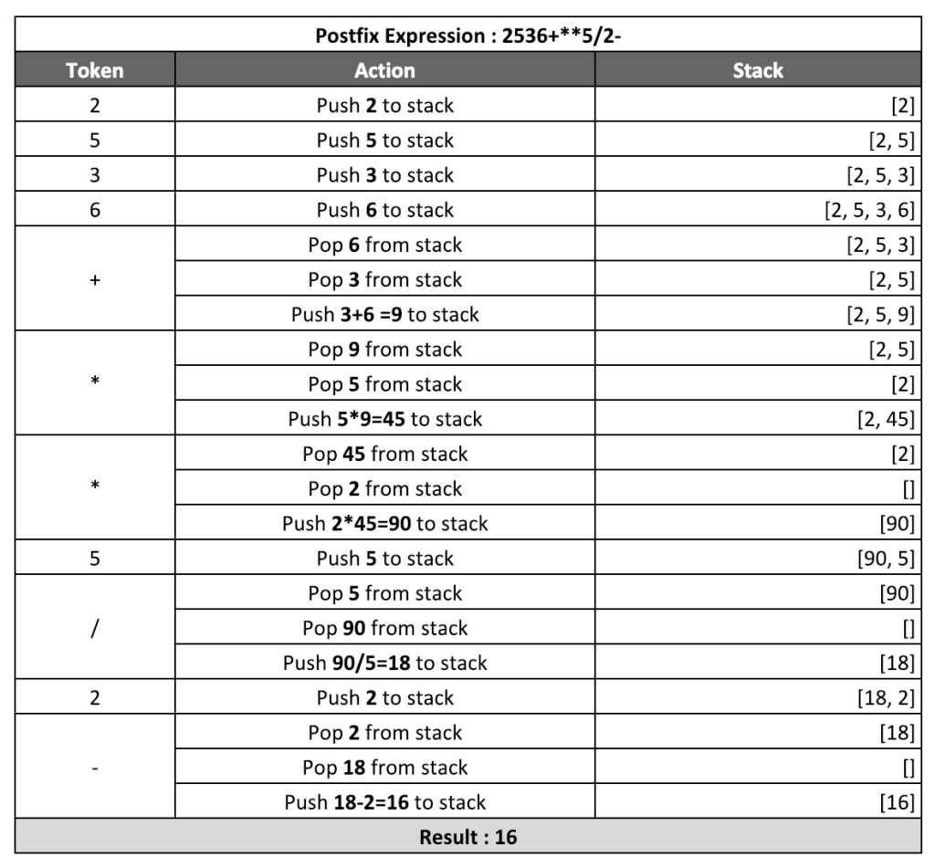

Slide 19
Evaluation of Prefix Expressions
Prefix notation is a notation for writing arithmetic expressions in which the operands appear after their operators.
There are no precedence rules to learn.
Let’s assume the below
Operands are real numbers in real digits.
Permitted operators: +,-, *, /, ^(exponentiation)
Blanks are NOT permitted in expression.
Parenthesis are permitted

Slide 20
Evaluation of Prefix Expressions
Example
Postfix: +54
Output: 9
Explanation: Infix expression of the above prefix is: 5+ 4 which resolves to 9
Postfix: -/*2*5+3652
Output: 16
Explanation: Infix expression of above prefix is: 2 * (5 *(3+6))/5-2 which resolves to 16

Slide 21
Evaluation of Prefix Expressions
Algorithm:
Reverse the given expression and Iterate through it, one character at a time
If the character is an operand, push it to the operand stack.
If the character is an operator,
pop the operand from the stack, say it’s s1.
pop another operand from the stack, say it’s s2.
perform (s1 operator s2) and push it to stack.
Once the expression iteration is completed, The stack will have the final result. pop from the stack and return the result.

Slide 22
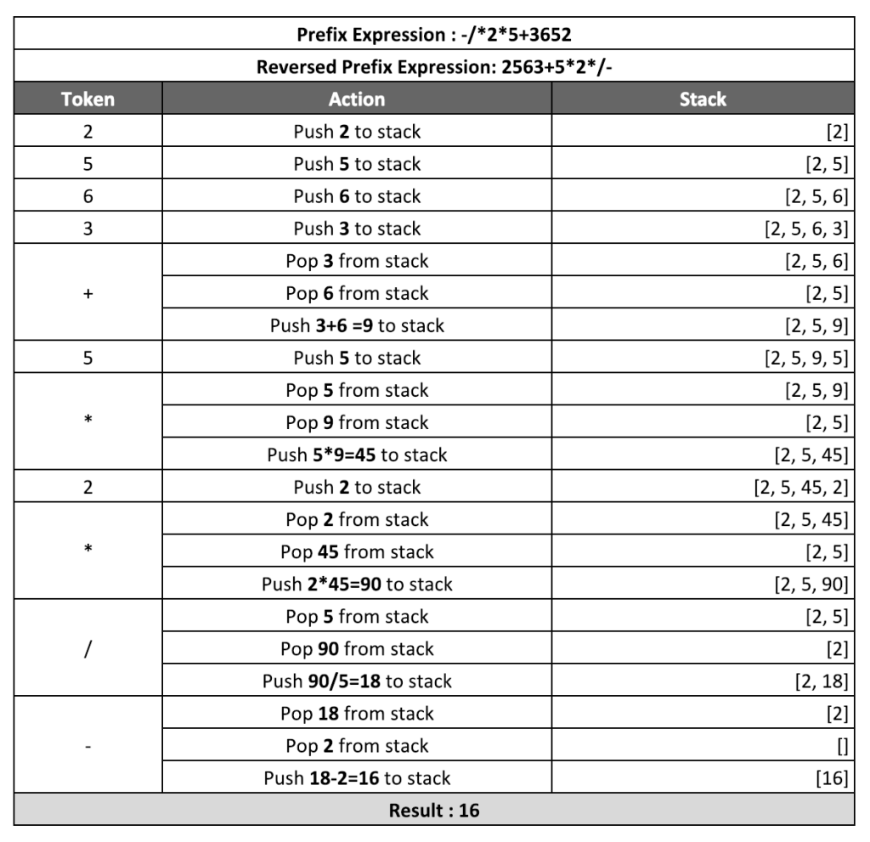

Slide 23
Conversion of Expression
While we use infix expressions in our day to day lives.
Computers have trouble understanding this format because they need to keep in mind rules of operator precedence and also brackets.
Prefix and Postfix expressions are easier for a computer to understand and evaluate.
Given two operands A and B an operator O, the infix notation implies that O will be applied in between A and B ie. A O B.
When the operator is placed after both operands ie. ABO, it is called postfix notation.
And when the operator is placed before the operands ie. OAB, the expression is prefix notation.

Slide 24
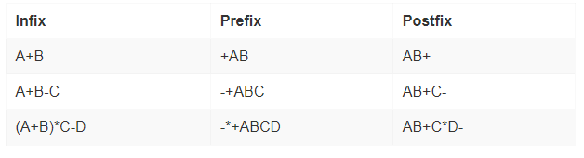
Conversion of Expression
Examples(Prefix)
Input : A * B + C / D
Output : + * A B/ C D
Input : (A - B/C) * (A/K-L)
Output : *-A/BC-/AKL
Examples(Postfix)
Input : A * B + C / D
Output : AB*CD/+
Input : (A - B/C) * (A/K-L)
Output : ABC/-AK/L-*

Slide 25
Conversion of Infix to Prefix using Stack
First, reverse the given infix expression.
Scan the characters one by one.
If the character is an operand, copy it to the prefix notation output.
If the character is a closing parenthesis, then push it to the stack.
If the character is an opening parenthesis, pop the elements in the stack until we find the corresponding closing parenthesis.
If the character scanned is an operator
If the operator has precedence greater than or equal to the top of the stack, push the operator to the stack.
If the operator has precedence lesser than the top of the stack, pop the operator and output it to the prefix notation output and then check the above condition again with the new top of the stack.
After all the characters are scanned, reverse the prefix notation output.

Slide 26
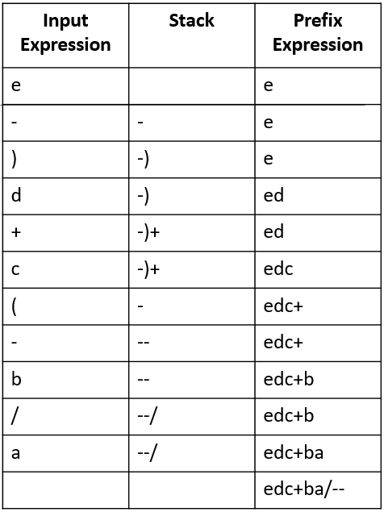
Conversion of Infix to Prefix using Stack
Example: a/b-(c+d)-e
After reversing, the notation becomes, e-)d+c(-b/a
Compute operation on table as per algorithm .
Now inverse prefix expression from the table
So, final prefix will be --/ab+cde

Slide 27
Conversion of Infix to Postfix using Stack
Let, X is an arithmetic expression written in infix notation. This algorithm finds the equivalent postfix expression Y.
Scan X from left to right and repeat Step 3 to 6 for each element of X until the Stack is empty.
If an operand is encountered, add it to Y.
If a left parenthesis is encountered, push it onto Stack.
If an operator is encountered ,then:
Repeatedly pop from Stack and add to Y each operator (on the top of Stack) which has the same precedence as or higher precedence than operator.
Add operator to Stack.
If a right parenthesis is encountered ,then:
Repeatedly pop from Stack and add to Y each operator (on the top of Stack) until a left parenthesis is encountered.
Remove the left Parenthesis.

Slide 28
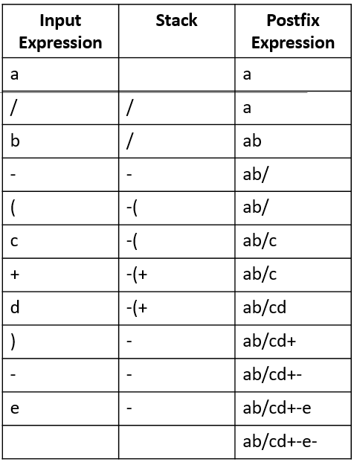
Conversion of Infix to Postfix using Stack
Example: a/b-(c+d)-e
Compute operation on table as per algorithm
The final postfix operation will be ab/cd+-e-

Slide 29
Conversion of Prefix to infix using Stack
Scan the given prefix expression from right to left character by character.
If the character is an operand, push it into the stack
But if the character is an operator, pop the top two values from stack.
Concatenate this operator with these two values (1st top value+operator+2nd top value) to get a new string.
Now push this resulting string back into the stack.
Repeat this process untill the end of prefix expression.
Now the value in the stack is the desired infix expression.

Slide 30
Conversion of Prefix to infix using Stack
Example: --/ab+cde
Result(Infix): (((a/b)-(c+d))-e)
Input String | Prefix Expression | Stack (Infix)
--/ab+cde | --/ab+cd | e
--/ab+cde | --/ab+c | ed
--/ab+cde | --/ab+ | edc
--/ab+cde | --/ab | e(c+d)
--/ab+cde | --/a | e(c+d)b
--/ab+cde | --/ | e(c+d)ba
--/ab+cde | -- | e(c+d)(a/b)
--/ab+cde | - | e((a/b)-(c+d))
--/ab+cde |  | (((a/b)-(c+d))-e)

Slide 31
Conversion of Postfix to infix using Stack
Scan the given postfix expression from left to right character by character.
If the character is an operand, push it into the stack.
But if the character is an operator, pop the top two values from stack.
Concatenate this operator with these two values (2nd top value+operator+1st top value) to get a new string.
Now push this resulting string back into the stack.
Repeat this process untill the end of postfix expression.
Now the value in the stack is the infix expression.

Slide 32
Conversion of Postfix to infix using Stack
Example:
Postfix: ab/cd+-e-
Infix: (((a/b)-(c+d))-e)
Input String | Postfix Expression | Stack (Infix)
ab/cd+-e- | b/cd+-e- | a
ab/cd+-e- | /cd+-e- | ab
ab/cd+-e- | cd+-e- | (a/b)
ab/cd+-e- | d+-e- | (a/b)c
ab/cd+-e- | +-e- | (a/b)cd
ab/cd+-e- | -e- | (a/b)(c+d)
ab/cd+-e- | e- | ((a/b)-(c+d))
ab/cd+-e- | - | ((a/b)-(c+d))e
ab/cd+-e- |  | (((a/b)-(c+d))-e)

Slide 33
Assignment
What is Data Structure? Show the status of stack converting following infix expression to post fix P + Q – (R*S/T+U)-V*W
What is stack? List the applications of stack. Write an algorithm or procedure to perform PUSH and POP operation in stack
what is data structure? Explain different operations to be performed on data structure.
Trace the algorithm to convert infix to postfix and prefix with following infix expression ((A+B)-C*D/E)*(H-I)*F+G and evaluate the obtained postfix and prefix expression with following values: A=4,B=2, C=4,D=3,E=8,F=2, G=3, H=5, I=1
What is dynamic memory allocation? Compare data structure with abstract datatype.

Slide 34
Assignment
How can you use stack to convert an infix expression to postfix? Convert infix expression
(A + B)*(C - D) to postfix using stack.
What do you mean by complexity of algorithms? How do you find time complexity? Explain with example.
What is ADT? Discuss stack as an ADT.
Describe Asymptotic Notation in details.
What is Postfix expression? Write an algorithm to evaluate value of postfix expression. Trace the following expression into postfix expression. (A+B*C)+(D-E/ F)
Transform the postfix expression AB−C+DEF+-+ to infix.

Slide 35
Assignment
Trace out Infix to Postfix conversion algorithm with given Infix expression.
A + (((B-C) * (D-E) + F)/G) * (H-I)
Evaluate the postfix expression acquired from above for the given values:
A = 6, B = 2, C = 4, D = 3, E = 8, F = 2, G = 3, H = 5, I = 1.
“To write an efficient program, we should know about data structures.” Explain the above statement.

